Slide 1
Online Retail Customer Segmentation
By-Kashfur Rahman Khan

Slide 2
content
Problem statement
Data description
Exploratory Data Analysis
Feature Engineering
RFM MODEL
k-means clustering
Hierarchial clustering
Conclusion

Slide 3
Problem Statement
Your task is to group customers of a UK-based online gift shop into different categories based on their buying behavior. The data set you will be working with includes all the transactions made between 01/12/2010 and 09/12/2011. This company does not have a physical store and mainly sells unique gifts that can be given on any occasion. Many of the customers are wholesalers who purchase items in bulk.

Slide 4
Data Description
1)InvoiceNo= Invoice number.
2)StockCode= Product code.
3)Description= Product name.
4)Quantity= The quantities of each product per transaction.
5)InvoiceDate=Invoice Date and time.
6)UnitPrice= product price.
7)CustomerID=Customer number.
8)Country=Country name.

Slide 5
Exploratory Data Analysis
Getting data information =online_retail_df.info()
Number of rows and column in dataset=online_retail_df.shape
Checking null values =online_retail_df.isnull().sum()
Filling Null values=online_retail_df['Description'].fillna('no description',inplace=True)
Description of data =online_retail_df.describe()

Slide 6
changing invoice date format to date-time format
online_retail_df['InvoiceDate']=pd.to_datetime(online_retail_df['InvoiceDate'])
check number of unique values in data
online_retail_df.nunique()
get list of cancelled order
cancelled_orders = online_retail_df[online_retail_df['InvoiceNo'].astype(str).str.contains('C')]
total cancelled orders
total_cancelled_orders=len(cancelled_orders['Quantity'])
9288

Slide 7
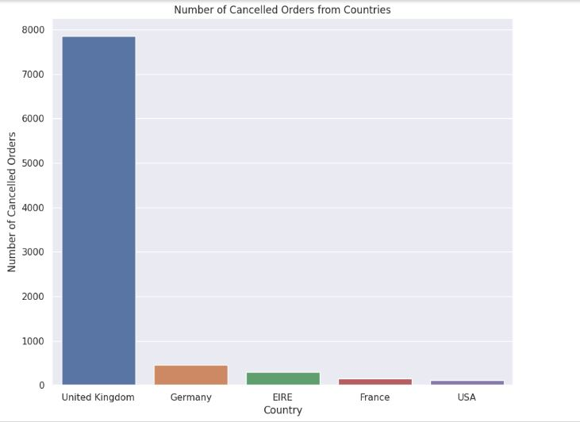
Countries with the most cancelled orders

Slide 8
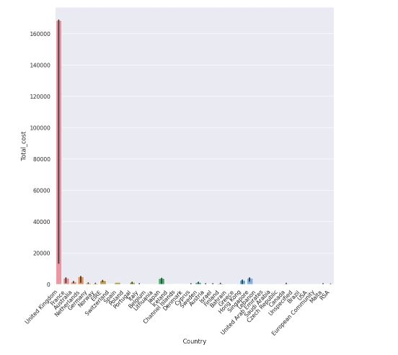
Revenue from each countries

Slide 9
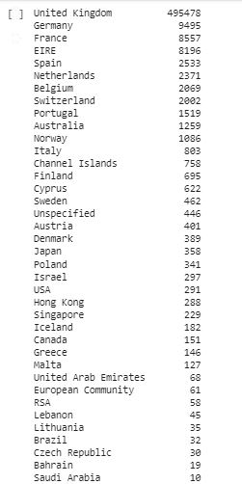
orders from each countries

Slide 10
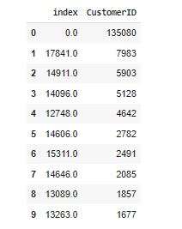
Top Customers

Slide 11
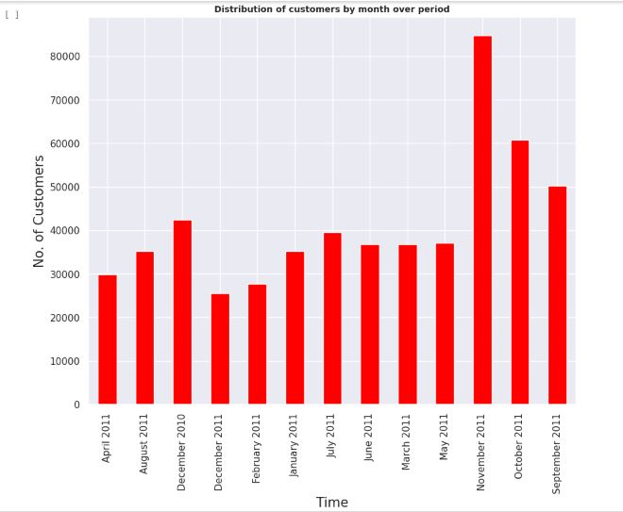
Customers Throughout the period

Slide 12
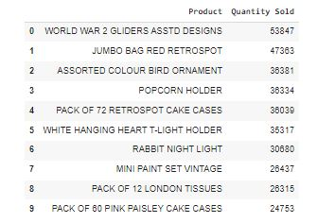
Top 10 selling products

Slide 13
Feature engineering
converting invoice data to date time
online_retail_df["InvoiceDate"] = pd.to_datetime(online_retail_df["InvoiceDate"], format="%Y-%m-%d %H:%M:%S")
Creating a new features from Invoicedate
online_retail_df['Month']=online_retail_df['InvoiceDate'].dt.month_name()
online_retail_df['Day']=online_retail_df['InvoiceDate'].dt.day_name()
online_retail_df['Hour']=online_retail_df['InvoiceDate'].dt.hour

Slide 14
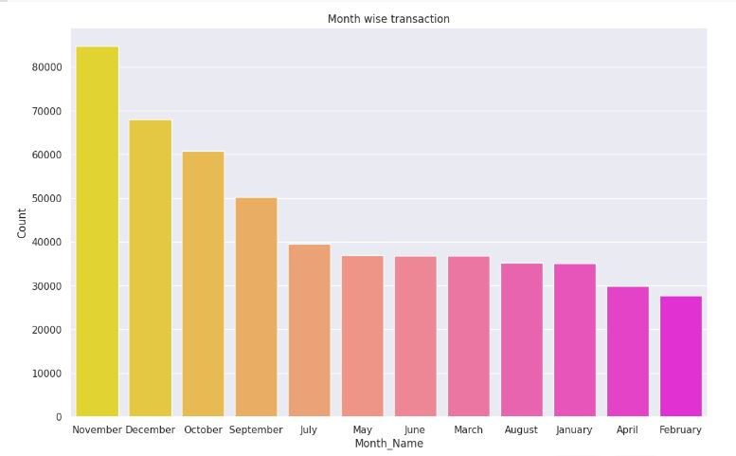
Month wise transaction

Slide 15
RFM model
RFM is a method used for analyzing customer value.

Slide 16
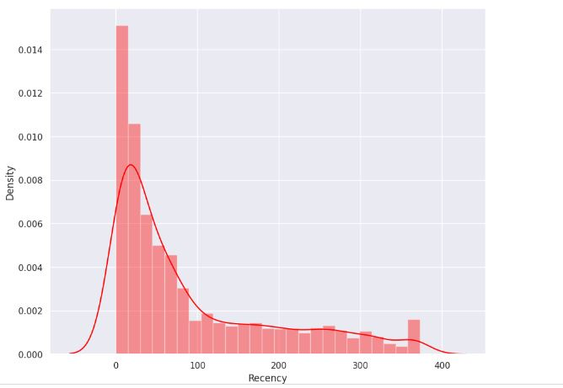
Recency

Slide 17
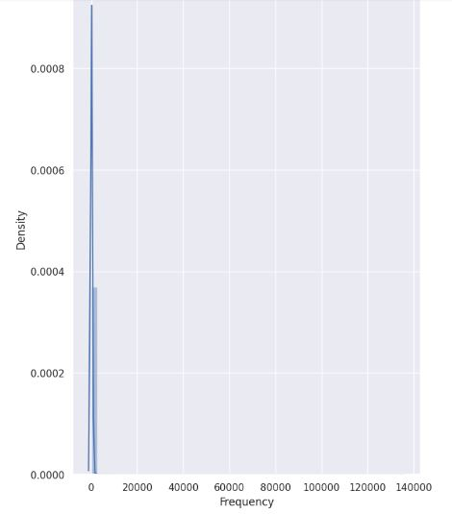
Frequency

Slide 18
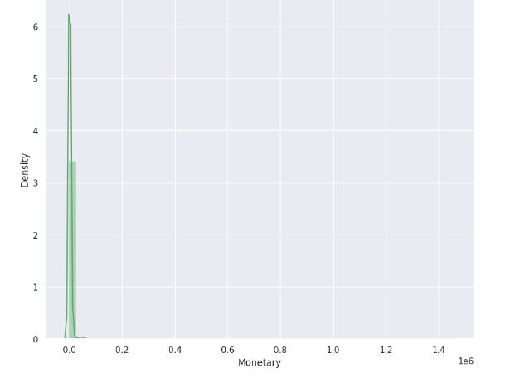
Monetary

Slide 19
K-Means Clustering
K-means clustering is a type of machine learning algorithm used to group together similar objects or data points based on their characteristics. It works by iteratively dividing the data into clusters, with each cluster containing objects that are closest together in terms of their features.

Slide 20
Hierarchical clustering
Hierarchical clustering is a type of machine learning algorithm used to group together similar objects or data points based on their characteristics in a tree-like structure, called a dendrogram.
It works by first considering each data point as a separate cluster, then iteratively merging the two closest clusters into a single larger cluster. This process continues until all the data points belong to a single cluster.

Slide 21
Conclusion
1)This project is focused on developing customer segments for a UK based online store.
2)Using a recency, frequency and monetary(RFM) analysis, the customers have been segmented into various clusters.
3)Two algorithms used-
k-means clustering
Hierarchial clustering

